Slide 1
Space Alert IRL
semester project (ročníkový projekt)
author: Tomáš Plhák
supervisor: Jakub Gemrot (vedoucí práce)
(name of the project may be temporary)

Slide 2
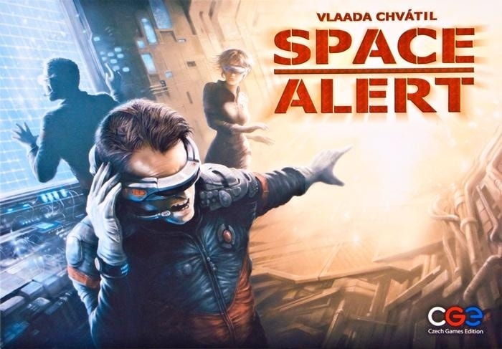
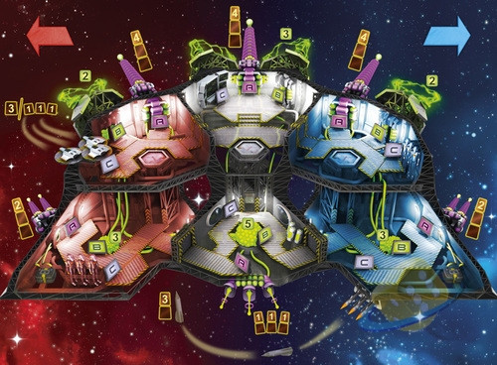
Space Alert – the board game
real-time
multiplayer cooperation
healthy dose of chaos

Slide 3
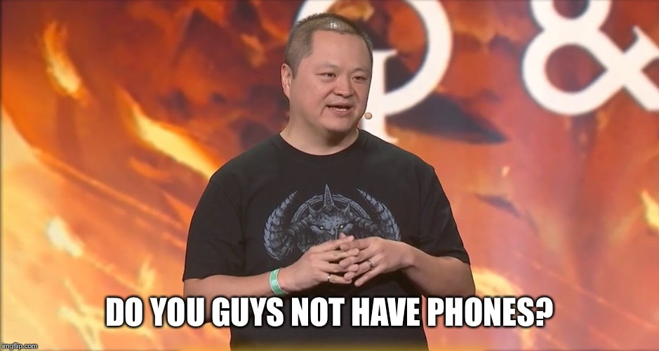
Do you guys not have phones?
Avantages
mobility
NFC
everyone has them

Slide 4

What does that mean?
the idea is to turn the players home into a small spaceship
  in order to move to the main canon the player will have to physically move to for example kitchen
NFC
  NFC tags are small integrated circuits, that can store small amount of data (string/...)
  nearly every phone has NFC reader, that can read those tags
  tags in our game world represent different places on the ship (bridge/elevator/laser/shields/...)
  those tags will be placed in different places in the game area (house/flat/...)

Slide 5
Implementation
game engine: Unity
NFC reader
  for now done by android plugin (only for androids)
multiplayer – MLAPI
  new in-house Unity multiplayer solution
  provides messaging system as well as keeping eye on NetworkObjects

Slide 6
Current stage
NFC reader
  is done for android
MLAPI
  proof of concept demos are mostly done
current goal
  create firs working ship prototype and few general enemies
  create first testing game scenario, so the game can start being play tested

Slide 7
Interesting places to go to
Space Alert – the board game
  https://czechgames.com/en/space-alert/
NFC for android
  https://developer.android.com/guide/topics/connectivity/nfc
MLAPI
  https://docs-multiplayer.unity3d.com/

